Slide 1
Overall
Description of background
With Celgene successfully integrated with BMS Japan, as well as re-organization of existing business unit of Oncology, operation changes are required for tracking prescription data in order to enhance patients’ experience and strengthen commercial capabilities. General situation of prescription data tracking for Japan market as below.
What is happened:
  Celgene integrated with BMS Japan - the collection of product information conducted by CKK became a joint effort
  Business unit re-organization - EMPLICITI, SPRYCEL,OP HL have been moved from ONC to Hema.
What is current situation:
  New BU Hema was launched. Oncology BU is divided into 2 sales orgs, ONC1 and ONC2. Respectively in charge of promoting products in slide 2.
  ONC2 products as well as EMPLICITI, SPRYCEL,OP HL using Patient prescription follow up to track patient level data
  CLG products using General survey to track patient level prescription data as interim solution
What is needed:
  Add new patient prescription data follow up page for Hema
  Update current prescription data follow up page for ONC

Slide 2
As is
Products promoted by BU
Hema
ISTODAX
REVLIMID Lymphoma
REVLIMID ATLL
SPRYCEL
OPDIVO HL
EMPLICITI
REVLIMID MM
POMALYST
REVLIMID MDS
ONC1
OPDIVO LUNG
OPDIVO RCC
OPDIVO+YERVOY RCC
OPDIVO H&N
OPDIVO MELANOMA
OPDIVO+YERVOY MELANOMA
YERVOY
ONC2
OPDIVO GC
OPDIVO ESOPHAGEAL
OPDIVO CRC
OPDIVO+YERVOY CRC
Moved from ONC2 to Hema

Slide 3
As is
Prescription follow up overview by function
Patient level Prescription follow up
Monthly Advanced Survey for follow up
General Survey for follow up
IM
ONC2
ONC1
hCLG products

Slide 4
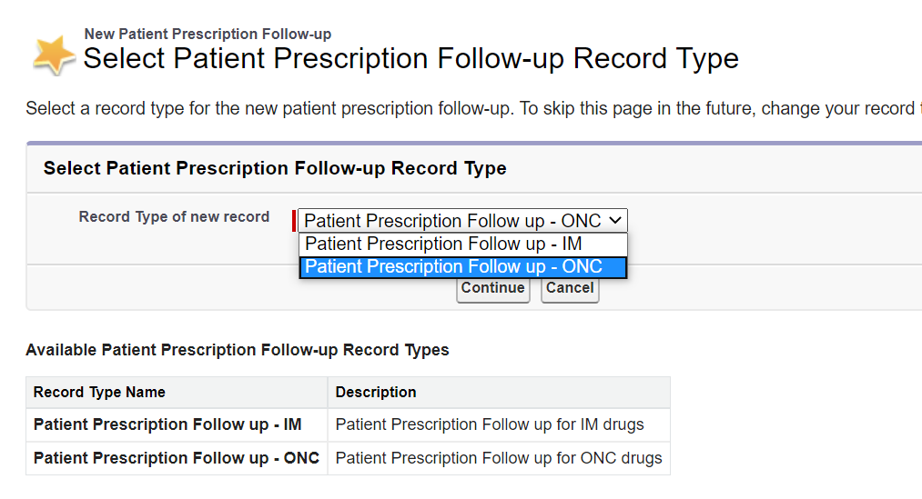
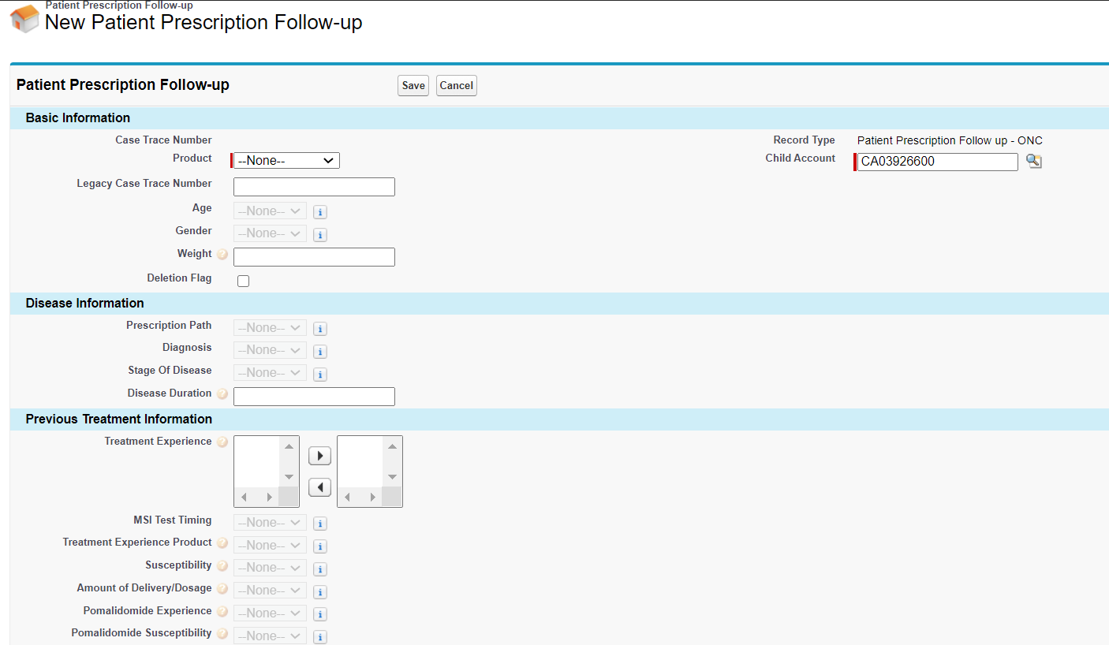
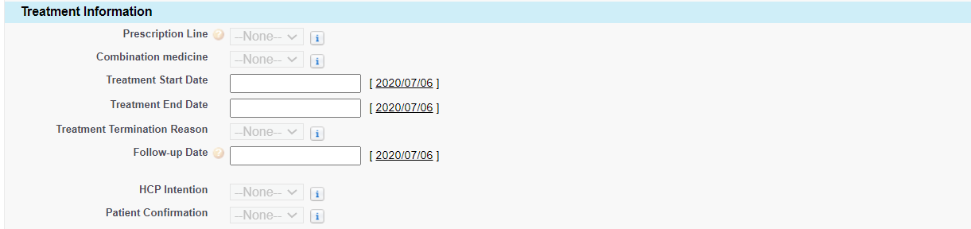
As is
Patient level prescription follow up(input page)

Slide 5

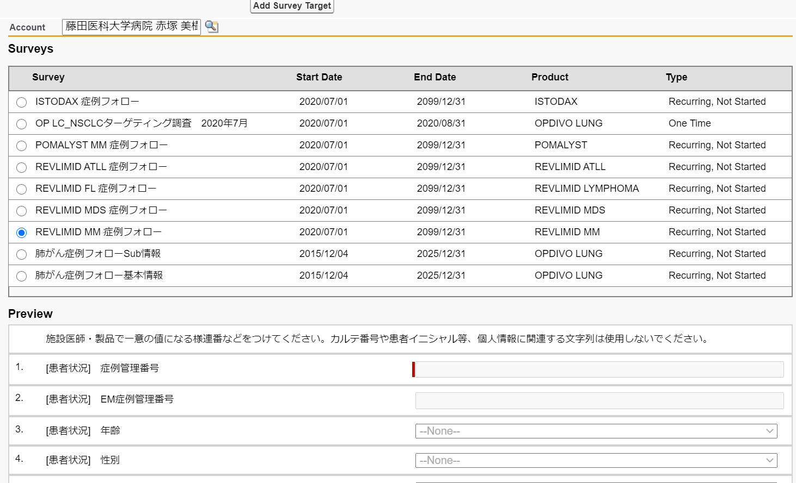
As is
General survey
Create survey for each hCLG product
Assign to target user territory
Publish new survey page to MR
Gather patient level prescription data from HCP
Record data on Survey page
Save record
Submit record and create another
Contact service desk to update submitted record

Slide 6


Problem Statement
Potentially Problems
integrity
EM/SP/OP HL remains on ONC page while these products have been moved to Hema
Need to moved related fields/dependencies to the right place
limitation
MR could not create a new record without submitting the record under edit
MR has to contact service desk to update submitted record

Slide 7
Requirement
Solutions
hCLG
Use patient prescription follow up instead general survey
Add new page for Hema
ONC
Remove/partially remove fields/dependencies related SP/EM/OP HL from ONC page
Add fields/dependencies to new Hema page
else
Create new attribute of therapeutic area for marketing analysis purpose
Create new report for Hema page

Slide 8
Requirement
High level overview of Asis/Tobe
Asis
Tobe
Patient prescription follow
Patient prescription follow
IM page
IM Page
ONC2 page
No change
Monthly advanced survey
ONC Page
Add ONC1 products to
ONC page
ONC1
General survey
Hema Page
Add hCLG products to Hema page
hCLG
Remove SP/EM/OP HL from ONC2 to Hema page

Slide 9
Business justification
General survey was originally for an interim purpose for collecting prescription data of hCLG products. Since CKK and BMS have successfully integrated, local business requires to use patient prescription follow-up custom object for tracking and a new page for Hema is required.
MR could not create a new record without submitting the record under edit. Once record is submitted, MR will have to contact service desk for data updating. This brings MR extra workload.
Since Products EM/SP/OP HL have been moved from onc2 to Hema, these products should be added to product pick list value in Hema page as well as related fields/dependencies.
For analysis purpose, business requires to be able to track prescription data by a new attribute Therapeutic Area. From the point of standardized specification, it is also necessary to update IM page according to this change.

Slide 10
Request
Add new screen(page layout) for Hema ,add hCLG products, as well as EM/SP/OP HL to Hema page product picklist as well as related fields/dependencies.
Add new attribute Therapeutic Area to all pages(ONC,IM,Hema) for marketing analysis purpose
Add new attributes for hCLG products special prescription follow up use case
No need to migrate general survey historical data ,but reports should not be left for reference.
Create Prescription follow up report for Hema page

Slide 11
Appendix
TA/Product list
Hema | Lymphoma | ISTODAX
 |  | REVLIMID Lymphoma
 |  | REVLIMID ATLL
 | Leukemia | SPRYCEL
 |  | OPDIVO HL
 | MM | EMPLICITI
 |  | REVLIMID MM
 |  | POMALYST
 | MDS | REVLIMID MDS

